Slide 1
Fourier Transform
and its applications

Slide 2
Fourier Transforms are used in
X-ray diffraction
Electron microscopy (and diffraction)
NMR spectroscopy
IR spectroscopy
Fluorescence spectroscopy
Image processing
etc. etc. etc. etc.

Slide 3
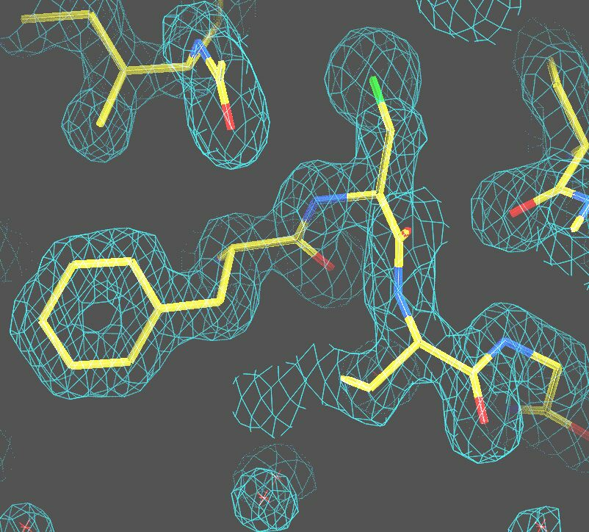
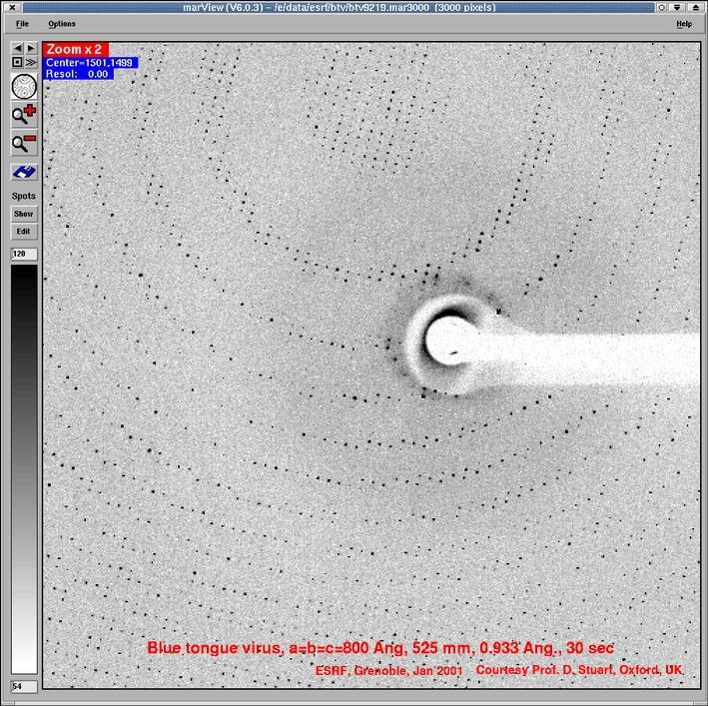

Slide 4
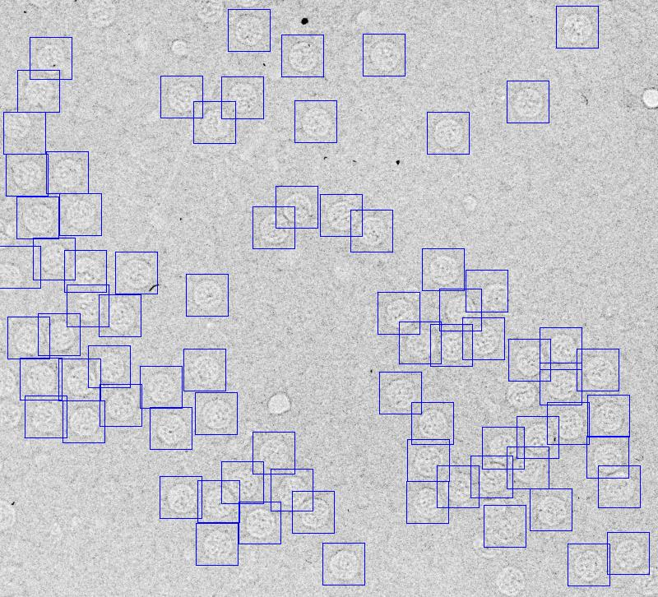
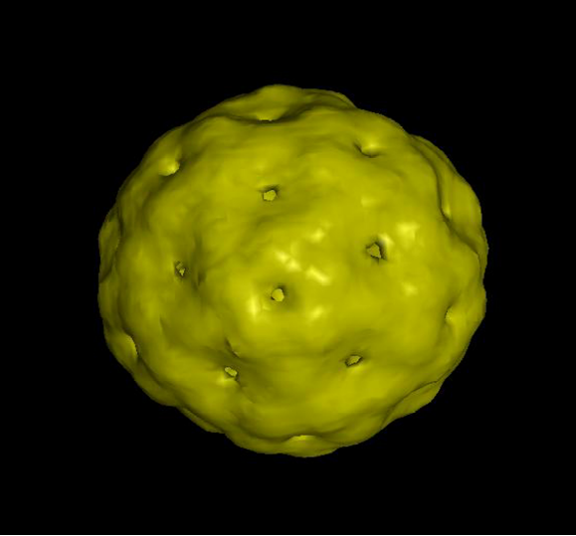
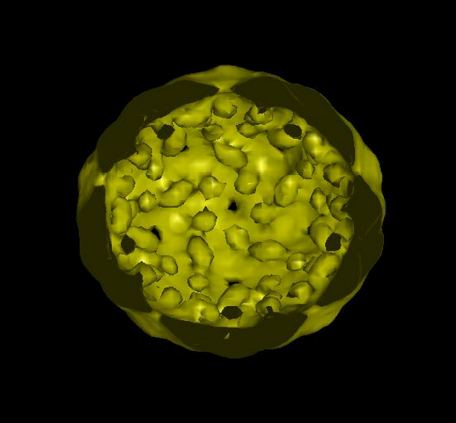

Slide 5
Fourier Transforms
Different representation of a function
  time vs. frequency
  position (meters) vs. inverse wavelength
In our case:
  electron density vs. diffraction pattern

Slide 6
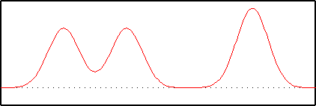
What is a Fourier transform?
A function can be described by a summation of waves with different amplitudes and phases.

Slide 7
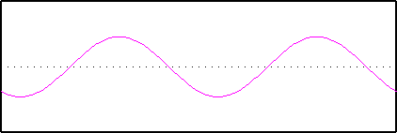
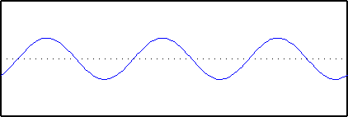
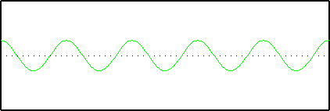

Slide 8
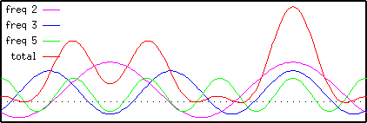
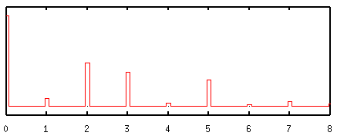

Slide 9
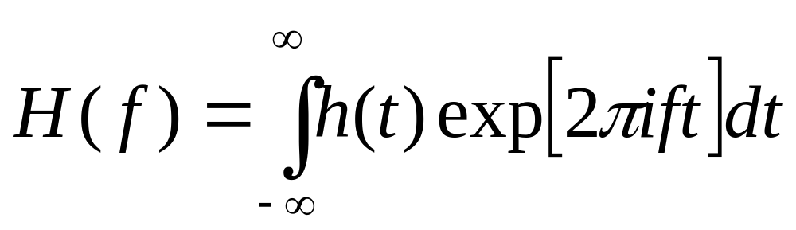
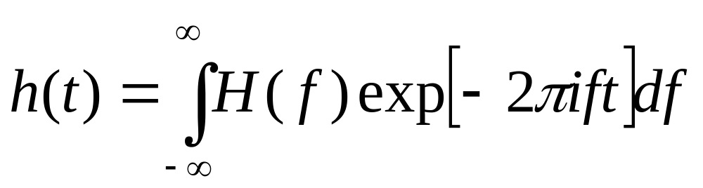
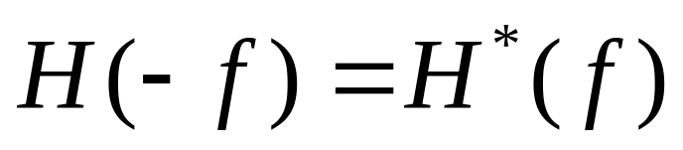
Fourier Transform
If h(t) is real:

Slide 10
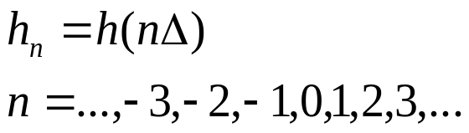
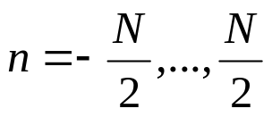
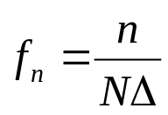
Discrete Fourier Transforms
Function sampled at N discrete points
  sampling at evenly spaced intervals
  Fourier transform estimated at discrete values:
  e.g. Images
Almost the same symmetry properties as the continuous Fourier transform

Slide 11
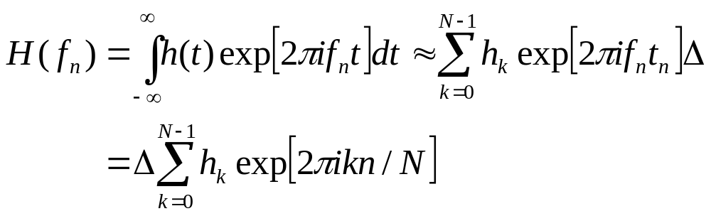
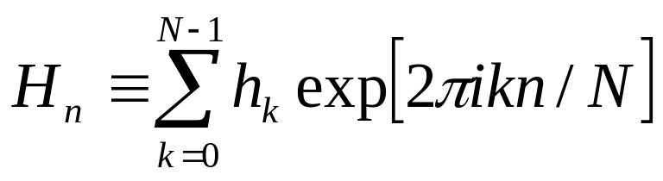
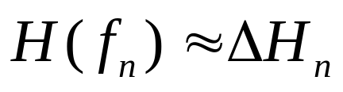
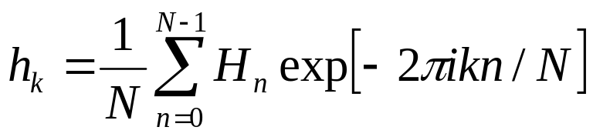
DFT formulas

Slide 12

Examples

Slide 13
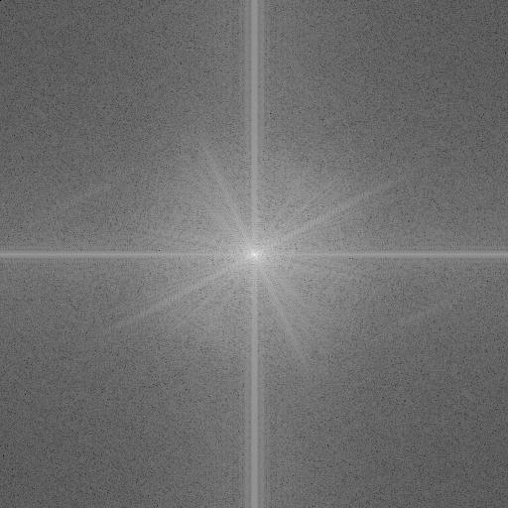

Slide 14
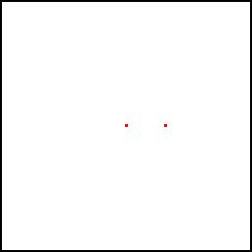
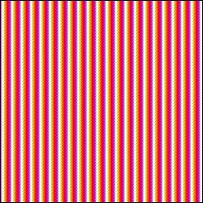
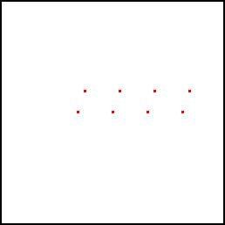
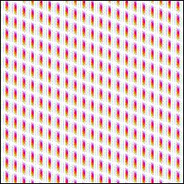

Slide 15
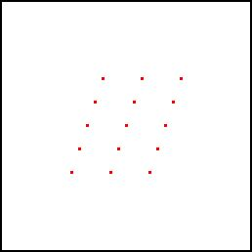
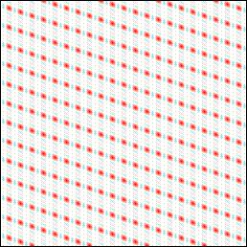

Slide 16

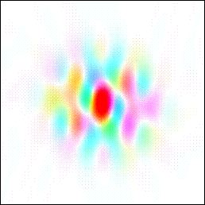
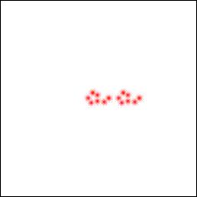
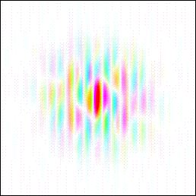

Slide 17
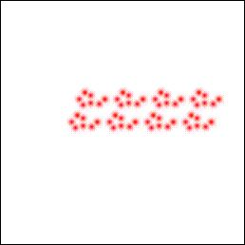
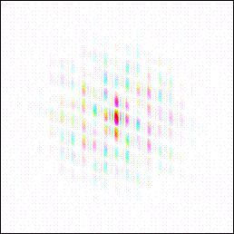
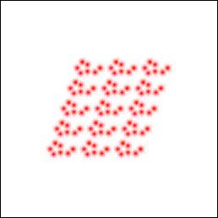
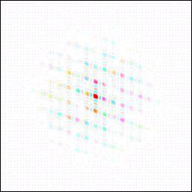

Slide 18

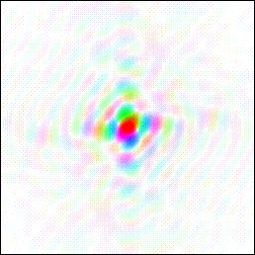
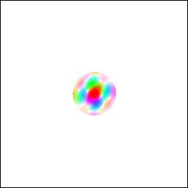
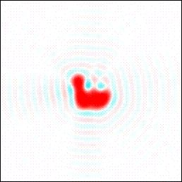

Slide 19
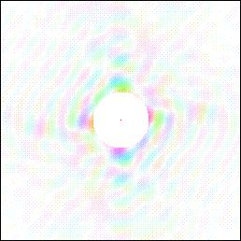
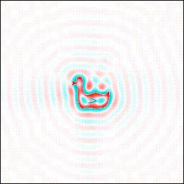
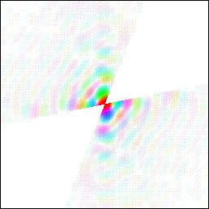
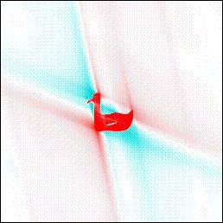

Slide 20
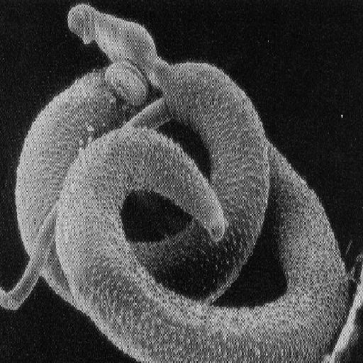

Slide 21
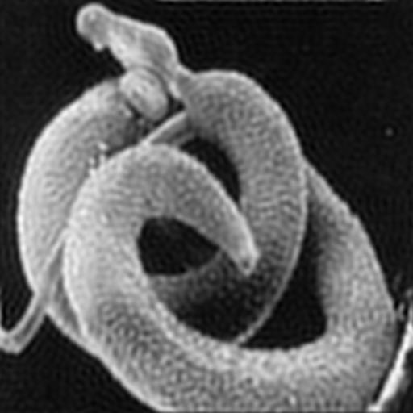

Slide 22
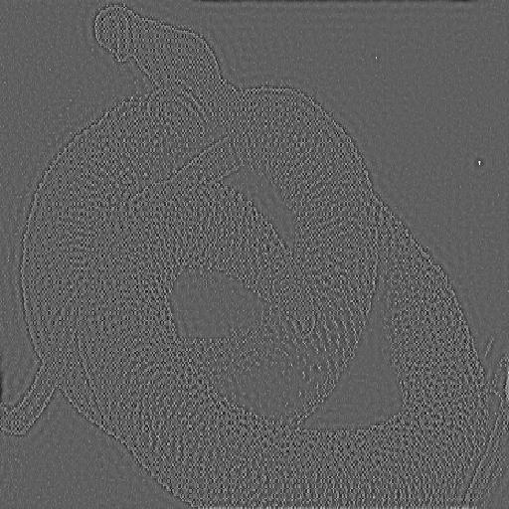

Slide 23


Slide 24
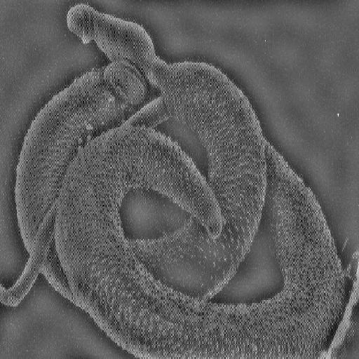

Slide 26
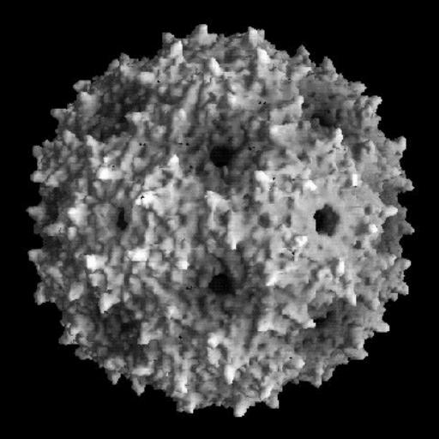

Slide 27
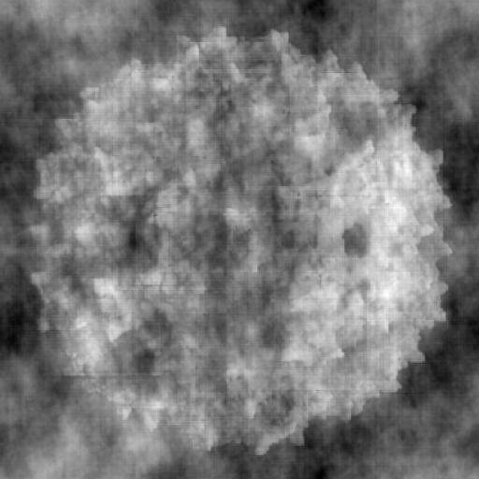

Slide 28
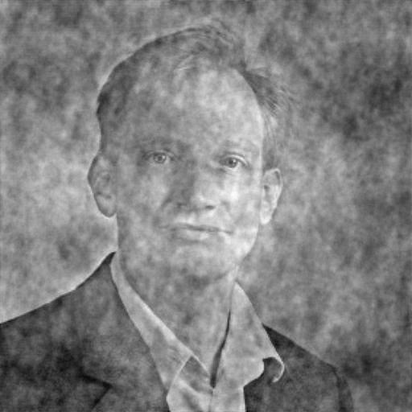

Slide 29

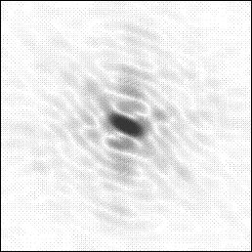



Slide 30


Slide 31
Properties of Fourier Transforms
Convolution Theorem
Correlation Theorem
Wiener-Khinchin Theorem (autocorrelation)
Parseval’s Theorem

Slide 32


Convolution
As a mathematical formula:
Convolutions are commutative:

Slide 33

Convolution illustrated

Slide 34



Convolution illustrated
⊗
=

Slide 35






Convolution illustrated

Slide 36

Convolution Theorem
The Fourier transform of a convolution is the product of the Fourier transforms
The Fourier transform of a product is the convolution of the Fourier transforms

Slide 37


Special Convolutions
Convolution with a Gauss function
Gauss function:
Fourier transform of a Gauss function:

Slide 38


The Temperature Factor

Slide 39


Convolution with a delta function
The delta function:
The Fourier Transform of a delta function

Slide 40


Structure factor:

Slide 41



Correlation Theorem

Slide 42



Slide 43


Slide 44


Autocorrelation

Slide 45


Calculation of the electron density
x,y and z are fractional coordinates in the unit cell
0 < x < 1

Slide 46



Calculation of the electron density

Slide 47

Calculation of the electron density
This describes F(S), but we want the electron density
We need Fourier transformation!!!!!
F(hkl) is the Fourier transform of the electron density
But the reverse is also true:

Slide 48

Calculation of the electron density
Because F=|F|exp(ia):
I(hkl) is related to |F(hkl)| not the phase angle alpha
===> The crystallographic phase problem

Slide 49
Suggested reading
http://www.yorvic.york.ac.uk/~cowtan/fourier/fourier.html and links therein
http://www.bfsc.leidenuniv.nl/ for the lecture notes

